Slide 1
Building Android apps – Week 7b
2843-201710_MCS4993_M:Topics in MA/CS
2843-201710_MCS5993_M:Topics in Computer Science
Notes:
Look at the

Slide 2
Agenda
Chapter 12 HFAD – Connecting to databases
Assignment - Daily horoscope app using Fragments (due 10/6)

Slide 3
Horoscope App
3 Features
Display each star sign
Display information about each star sign
Display horoscope for star sign in fragment

Slide 4
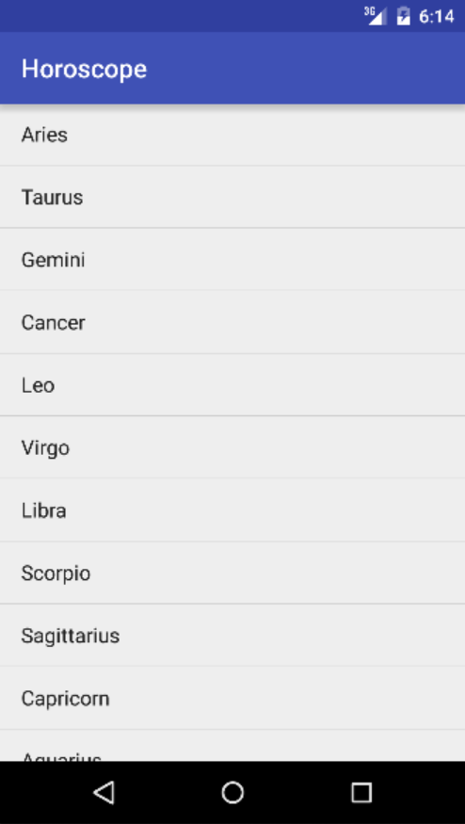
Notes:
Highlighted what needs to be in a fragment, should be on a RHS if it’s a tablet

Slide 5
Bullet Points
A Cursor lets you read from and write to the database.
You create a cursor by calling the SQLiteDatabase query() method. Behind the scenes, this builds a SQL SELECT statement.
The getWritableDatabase() method returns a SQLiteDatabase object that allows you to read from and write to the database.
The getReadableDatabase() returns a SQLiteDatabase object. This gives you read-only access to the database. It may also allow you to read from and write to the database, but this isn’t guaranteed.
Navigate through a cursor using the moveTo*() methods.
Get values from a cursor using the get*() methods.

Slide 6
Bullet Points
Close cursors and database connections after you’ve finished with them.
A CursorAdapter is an adapter that works with cursors. Use SimpleCursorAdapter to populate a ListView with the values returned by a cursor.
Design your app so that you put useful content in your top-level activity.
The CursorAdapter changeCursor() method replaces the cursor currently used by a cursor adapter to a new cursor that you provide. It then closes the old cursor.
Run your database code in a background thread using AsyncTask.

Slide 7
Chap 12 – Connecting to Databases

Slide 9
App changes
Update the Drink code in DrinkActivity.
Update the Drink code in DrinkCategoryActivity.
Let users choose their favorite drinks.
Notes:
Update the Drink code in DrinkActivity.
DrinkActivity uses the Drink class to display the details it has for a given drink. We’ll change the activity so that it retrieves the record for that drink from the Starbuzz database.
Update the Drink code in DrinkCategoryActivity.
DrinkCategoryActivity uses the Drink class to display a list of all the drinks. We’ll change this so that the activity displays a list of all the records in the DRINK table.
Let users choose their favorite drinks.
In Chapter 11, we upgraded the database so that the DRINK table includes a FAVORITE column. We’ll change the app so that users can flag which drinks are their favorites, and display a list of these favorites in TopLevelActivity.

Slide 10
Notes:
Here’s what it will look like moving forward

Slide 11
Notes:
DrinkActivity

Slide 12
Notes:
Here’s a reminder of what the current DrinkActivity.java code looks like. The onCreate() method gets the drink number selected by the user, gets the drink details from the Drink class, and then populates the activity’s views using the drink attributes:

Slide 13
Notes:
A database query gives you a way of saying exactly which records you want access to from the database. As an example, you can say you want to access all the data from the DRINK table, or just those drinks whose name begins with “L”. The more you can restrict the data you return, the more efficient your query will be.
The first thing to specify in your query is which table you want to get records from, and which columns you need.

Slide 14
Notes:
DECLARE ANY CONDITIONS THAT RESTRICT YOUR SELECTION
Once you’ve said what columns you want, you can filter your data by declaring any conditions the data must meet. In our app, for example, we want to retrieve the drink the user selected, and we can do this by only returning records where the drink _id has a particular value.

Slide 15
Select
NAME, DESCRIPTION, IMAGE_RESOURCE_ID
From
DRINK
Where
_id = 1;
Notes:
You can use this version of the query() method to specify which table you want to return data from, which columns you want, what conditions you want to apply to the data, what data aggregations you need, and how you want the data ordered.
Behind the scenes, Android uses the query() method to construct an SQL SELECT statement.
There are several other overloaded versions of the query() method which allow you to add extra details to your query, such as whether you want each row to be unique, and the maximum number of rows you want to be returned.

Slide 16
Select
NAME, DESCRIPTION
From
DRINK;
Notes:
The simplest type of database query you can create is to return all the records for particular columns without specifying criteria. To do this, put the name of the table as the first parameter, and a String array of the column names as the second. As an example, here’s how you’d use the query() method to return the contents of the name and description columns from the DRINK table:

Slide 17
Select NAME, DESCRIPTION From DRINK Where NAME = ”Latte”;
Notes:
RESTRICT YOUR QUERY BY APPLYING CONDITIONS
You can apply conditions to your database query by specifying what values particular columns should have using the third and fourth query parameters. As an example, here’s how you’d say you only want to return records from the DRINK table where the name of the drink is “Latte”:
The third parameter "NAME = ?" means that the NAME column should equal some value. The ? symbol is a placeholder symbol for this value. The query uses the contents of the fourth parameter to say what the value should be (in this case, “Latte”).

Slide 18
Select NAME, DESCRIPTION From DRINK
Where NAME = ”Latte” or DESCRIPTION = “Our best drip coffee”
Notes:
Applying multiple conditions to your query
If you want to apply multiple conditions to your query, you need to make sure you specify the conditions in the same order you specify the values. As an example, here’s how you’d return records from the DRINK table where the name of the drink is “Latte”, or the drink description is “Our best drip coffee”.

Slide 19
Select
NAME, DESCRIPTION
From
DRINK
Where
_id = 1;
Notes:
YOU SPECIFY CONDITIONS AS STRING VALUES
The condition values must be Strings. If the column you’re applying the condition to doesn’t contain text, you still need to convert your values to Strings. As an example, here’s how you’d return DRINK records where the _id is 1:

Slide 20
Select
NAME, FAVORITE
From
DRINK
Order By
NAME ASC;
Notes:
If you want to display data in your app in a particular order, you can use the query to sort the data by a particular column.
This can be useful if, for example, you want to display drink names in alphabetical order.
If you wanted to retrieve data from the NAME and FAVORITE column in ascending NAME order, you could use the following:

Slide 21
Select
NAME, FAVORITE
From
DRINK
Order By
FAVORITE DESC, NAME ASC;
Notes:
The ASC keyword means that you want to order that column in ascending order. Columns are ordered in ascending order by default, so if you want you can omit the ASC. To order the data in descending order instead, you’d use DESC.
You can sort by multiple columns too. As an example, here’s how you’d order by FAVORITE in descending order, followed by NAME in ascending order:

Slide 22
SQL FUNCTION | DESCRIPTION
AVG() | The average value
COUNT() | The number of rows
SUM() | The sum
MAX() | The largest value
MIN() | The smallest value
Notes:
Using SQL functions in queries
If you’re familiar with SQL functions, the great news is you can use them in queries. They allow you to retrieve things like the number of rows in a table, the average value of a column, or the highest value.
Here are some of the most useful SQL functions you can use in your queries:

Slide 23
Select COUNT(_id) as count From DRINK;

Slide 24
Notes:
If the DRINK table contained an extra PRICE column that gave the price of each drink, you could find out the average drink price using the SQL AVG() function to find the average value of the PRICE column:

Slide 25
Select FAVORITE, count(_id) as count From DRINK Group by FAVORITE;
Notes:
If you’re familiar with the GROUP BY and HAVING clauses of SQL, you can use these in the fifth and sixth parameters of the query() method.
As an example, suppose you wanted to find out how many drinks there are for each value of FAVORITE. To do this, you’d create a query to return the FAVORITE column and a count of drinks. You’d then group by the FAVORITE column to return the number of drinks there are for each value of FAVORITE:

Slide 27
Notes:
The query() method is defined in the SQLiteDatabase class, which means in order to call it we need to get a reference to our Starbuzz database. The SQLiteOpenHelper class implements a couple of methods that can help us with this:getReadableDatabase() and getWritableDatabase(). Each of these methods returns an object of type SQLiteDatabase, which gives us access to the database.
If you only need read data from a database, you’re best off using the getReadableDatabase() method. If you need to write to the database, use thegetWritableDatabase() method instead.

Slide 28
Notes:
You’ll probably be able to write to the database if you use getReadableDatabase(), but it’s not guaranteed.

Slide 30
Select NAME, DESCRIPTION, IMAGE_RESOURCE_ID From Name Where _id = drinkNo
Notes:
We’re doing a Select NAME, DESCRIPTION, IMAGE_RESOURCE_ID From Name Where _id = drinkNo
We’ll use this code later in the onCreate() method of our activity.
WHAT THE CODE DOES
The starbuzzDatabaseHelper is created.
starbuzzDatabaseHelper creates a SQLiteDatabase object called db.
The cursor is created by calling the SQLiteDatabase query() method.

Slide 31
Notes:
WHAT THE CODE DOES
The starbuzzDatabaseHelper is created.
starbuzzDatabaseHelper creates a SQLiteDatabase object called db.
The cursor is created by calling the SQLiteDatabase query() method.

Slide 32
Notes:
To read a record from a cursor, you first need to navigate to it
You’ve now seen how to create a cursor; you use the SQLiteDatabase query() method to say what data you want the cursor to return. But that’s not the end of the story—we need to read values from it.
Whenever you need to retrieve values from a particular record in a cursor, you first need to navigate to that record. You need to do this irrespective of how many records are returned by the cursor.

Slide 33
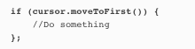
Notes:
There are four main methods you use to navigate through the records in a cursor.
These methods are moveToFirst(), moveToLast(), moveToPrevious(), and moveToNext().
To get access to the first record returned by the cursor, you can use its moveToFirst() method (it returns a value of true if it finds a record, and false if the cursor hasn’t returned any records):

Slide 34
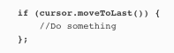
Notes:
If you want to navigate to the last record returned by the cursor, you can use the moveToLast() method instead (just like the moveToFirst() method, it returns a value of true if it finds a record, and false if it doesn’t):

Slide 35
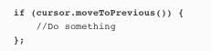
Notes:
To iterate through the records in the cursor, you use the moveToPrevious() and moveToNext() methods.
The moveToPrevious() method moves you to the previous record in the cursor (it returns true if it succeeds in moving to the previous record, and false if it fails—which could be because it’s already at the first record, or because the cursor doesn’t contain any records):

Slide 36
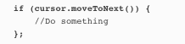
Notes:
The moveToNext() method works in the same way as the moveToPrevious() method, except that it moves you to the next record in the cursor (it returns true if it succeeds in moving to the next record, and false if it fails):

Slide 37
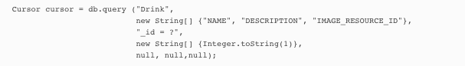
Notes:
Once you’ve moved to a record in a cursor, you can retrieve values from it so that you can display them in your activity’s views.
You retrieve a value from the current record in a cursor using its get*() methods. The exact method you use for this depends on the type of value you want to retrieve. As an example, the getString() method returns the value of a column as a String, and the getInt() method returns the value of a column as an int. Each of the methods takes a single parameter, the column index.

Slide 38
Notes:
If you wanted to get the value of the NAME column for the current record. NAME is the first column in the cursor, and contains String values. You’d therefore get the contents of the NAME column using the getString() method like this:

Slide 39
cursor.close();
db.close();
Notes:
FINALLY, CLOSE THE CURSOR AND DATABASE
Once you’ve finished retrieving values from the cursor, you need to close the cursor and the database in order to release their resources. You do this by calling the cursor and database close() methods:

Slide 40
Notes:
DrinkActivity

Slide 42
Notes:
Now that we’ve finished updating the DrinkActivity.java code, let’s look at the app structure diagram to see what we’ve done, and what we need to do next.
DrinkActivity now gets all of its drink data from the Starbuzz database. Next, we need to update the code in DrinkCategoryActivity so that it uses data from the database rather than from the Java Drink class.

Slide 44
Notes:
Here’s a reminder of what the current DrinkCategoryActivity.java code looks like. The onCreate() method populates a ListView with drinks using an ArrayAdapter. The onListItemClick() method adds the drink the user selects to an intent, and then starts DrinkActivity:

Slide 45
Notes:
The listDrinks list view gets its data from the Drink.drinks array. Now, what we could do is read the list of drinks from the database, and then store them in an array that we pass to the array adapter.That would work, but can you think of a reason why that might be a bad idea?

Slide 46
Notes:
For our very small database, there’s no real problem in reading all of the data from the database and storing it in an array in memory. But if you have an app that stores a very large amount of data, then it’s going to take some time to read it all out of the database. It may also take a lot of memory to store it all in an array some place.Instead, we’re going to switch from using an ArrayAdapter to a CursorAdapter.

Slide 47
Notes:
A CursorAdapter reads just enough data
say Starbuzz massively extended its range of artisan coffees so we need to store 300 drinks in the database.
But we can only see a few at a time in the list. The ListView can only display a limited number of items at one time.
On a small device, it might only initially show, say, the first 11 coffees.
If we were using an array, we would have to read all 300 coffees from the database into the array before we could display any on the screen.
That’s not how it works with a CursorAdapter.
The ListView gets displayed on the screen.
When the list is first displayed, it will be sized to fit the screen. Let’s say it has space to show five items.

Slide 48
Notes:
The ListView asks its adapter for the first five items.
The ListView doesn’t know where the data is coming from—whether it’s an array or a database—but it does know that it will be given the data by its adapter. So it makes a request to the adapter for the first five drinks.
The CursorAdapter asks its cursor to read five rows from the database.
A CursorAdapter is given a cursor when it’s constructed, and it will ask the cursor for data only when it needs it.
The cursor reads the first five rows from the database.
Even though the database table contains 300 rows, the cursor only needs to read the first five. That’s a lot more efficient, and it means that the screen can start displaying data much sooner.

Slide 49
Notes:
The user scrolls the list.
As the user scrolls the list, the CursorAdapter asks the cursor to read a few more rows from the database. If the user scrolls the list just a little, and uncovers one new item, the cursor will read one more row from the database.
So a CursorAdapter is a lot more efficient than the ArrayAdapter. It only reads the data it needs. That means it’s faster and takes up less memory, and speed and memory are both important things to keep in mind.

Slide 50
Notes:
A SimpleCursorAdapter maps data to views
We’re going to create a simple cursor adapter to use with our app. A SimpleCursorAdapter is an implementation of CursorAdapter that can be used in most cases where you need to display cursor data in a list view. It takes columns from a cursor, and maps them to TextViews or ImageViews.

Slide 51
Notes:
In our case, we want to display a list of drink names in our DrinkCategoryActivity list view, so we’ll use a simple cursor adapter to map the name of each drink to a text view in the list view:

Slide 52
Notes:
FIRST, CREATE THE CURSOR
The first thing to think about when creating a cursor to use with a cursor adapter is what columns the cursor needs to contain. The cursor should include all the columns that need to be displayed in the list view, along with a column called _id. The _id column must be included, or the cursor adapter won’t work. We need to give the cursor the primary key column in a table the name _id. This is so integral to Android that the cursor adapter assumes that this column will be there, and uses it to uniquely identify each row in the cursor. When you use a cursor adapter with a list view, the list view uses this column to identify which row the user has clicked.
As we’re using a cursor adapter to display the names of the drinks, our cursor must contain the _id and NAME columns like this:

Slide 53
Notes:
To create a simple cursor adapter, you need to tell it how you want the data to be displayed, which cursor to use, and which columns should be mapped to which views. Here’s how you’d create a simple cursor adapter to display a list of drink names:
Just as we did with the array adapter, we’re using android.R.layout.simple_list_item_1 to tell Android that we want to display each row in the cursor as a single text view in the list view. This text view has an ID of android.R.id.text1.

Slide 54
Notes:
The general form of the SimpleCursorAdapter constructor looks like this:
The context and layout parameters are exactly the same ones you used when you created an array adapter. context is the current context, and layout says how you want to display the data. Instead of saying which array we need to get our data from, we need to specify which cursor contains the data using the cursor parameter. You then use fromColumns to specify which columns in the cursor you want to use, and toViews to say which views you want to display them in.
The flags parameter is generally set to 0, which is the default. The alternative is to set it to FLAG_REGISTER_CONTENT_OBSERVER to register a content observer that will be notified when the content changes. We’re not covering this here, as it can lead to memory leaks. Later in the chapter, you’ll see how to deal with the underlying data changing.

Slide 55
Notes:
Closing the cursor and database
When we introduced you to cursors earlier in the chapter, we said that you needed to close the cursor and database after you’d finished with it in order to release their resources. In our DrinkActivity code, we used a cursor to retrieve drink details from the database, and once we’d used these values with our views, we immediately closed the cursor and database.
When you use a cursor adapter, it works slightly differently; the cursor adapter needs the cursor to stay open in case it needs to retrieve more data from it. This will happen if the user scrolls down the list of items in the list view, and needs to see more data.

Slide 56
Notes:
This means that you can’t immediately close the cursor and database once you’ve used the setAdapter() method to connect it to your list view. Instead, you can use the activity’s onDestroy() method to close them. As the activity’s being destroyed, there’s no further need for the cursor or database connection, so they can be closed:

Slide 59
Notes:
But now the data is being read from the database. In fact, you can now delete the Drink.java code, because we no longer need the array of drinks. Every piece of data we need is now coming from the database.

Slide 61
Notes:
We’re going to change the Starbuzz top-level activity by adding the users favorite drinks to it, and allowing them to click straight through to the drink they select.

Slide 63
Notes:
That’s enough to make sure the value of the FAVORITE column is displayed in the checkbox. Next, we need to get the checkbox to update the database when it’s clicked.

Slide 64
database.update(String table,
ContentValues values,
String whereClause,
String[] whereArgs);
Notes:
we want to update the DRINK table’s FAVORITE column with the value of the checkbox, and we can do this using the update() method.

Slide 67
Notes:
Display favorites in TopLevelActivity
The final thing we need to do is display the user’s favorite drinks in TopLevelActivity.
We need to add a new ListView to the layout.
This will display a list of the user’s favorite drinks.
We need to populate the ListView.
We’ll populate the list with the user’s favorite drinks from the database.
We need to get the ListView to respond to clicks.
If the user clicks on one of their favorite drinks, we’ll display details of the drink in DrinkActivity.

Slide 69
Notes:
We need to create a cursor to populate the ListView.
The cursor will return all drinks where the FAVORITE column has been set to 1—all drinks that the user has flagged as being a favorite. Just as we did in our code for DrinkCategoryActivity, we can connect the cursor to the ListView using a CursorAdapter.

Slide 70
Notes:
We need to create an onItemClickListener so that the ListView can respond to clicks.
If the user clicks on one of her favorite drinks, we can create an intent that starts DrinkActivity, passing it the ID of the drink that was clicked. This will show the user details of the drink they’ve just chosen.

Slide 73
Notes:
The above code populates a list view with the user’s favorite drinks. When the user clicks on one of these drinks, an intent starts DrinkActivity and passes it the ID of the drink. Details of the drink are then displayed. We’ll show you this running on the next page, along with a problem we need to sort out.

Slide 76
Notes:
The solution is to change the underlying cursor used by the favorites list view to a new version when the user returns to TopLevelActivity. If we do this in the activity’s onRestart() method, the data in the ListView will get refreshed when the user returns to TopLevelActivity. Any new favorite drinks the user has chosen will be displayed, and any drinks that are no longer flagged as favorites will be removed from the list.
To do this, we can use the CursorAdapter changeCursor() method. The changeCursor() method replaces the cursor currently used by a cursor adapter to a new one, and closes the old cursor. Here’s what the method looks like:

Slide 79
Notes:
CURSORS GIVE YOU ACCESS TO DATABASE DATA
A cursor gives you access to database recordsets. You specify what data you want access to, and the cursor brings back the records from the database. You then navigate through the records supplied by the cursor.

Slide 80
Extra Credit
SQLCipher
SQLiteBrowser
AsyncTasks

Slide 81
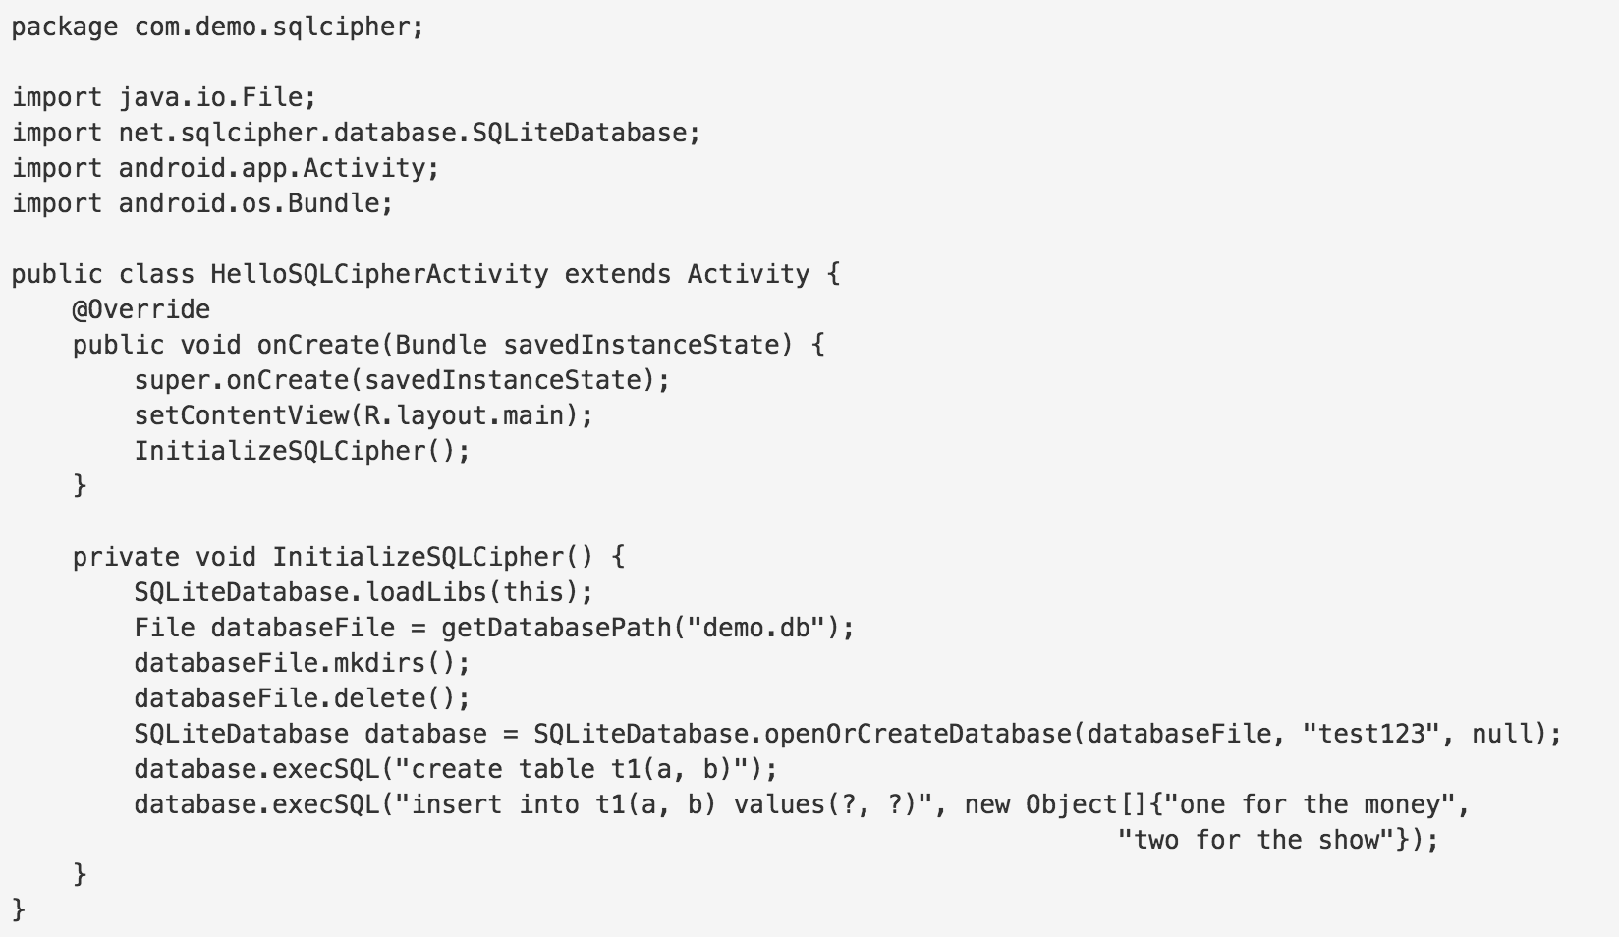

Slide 82
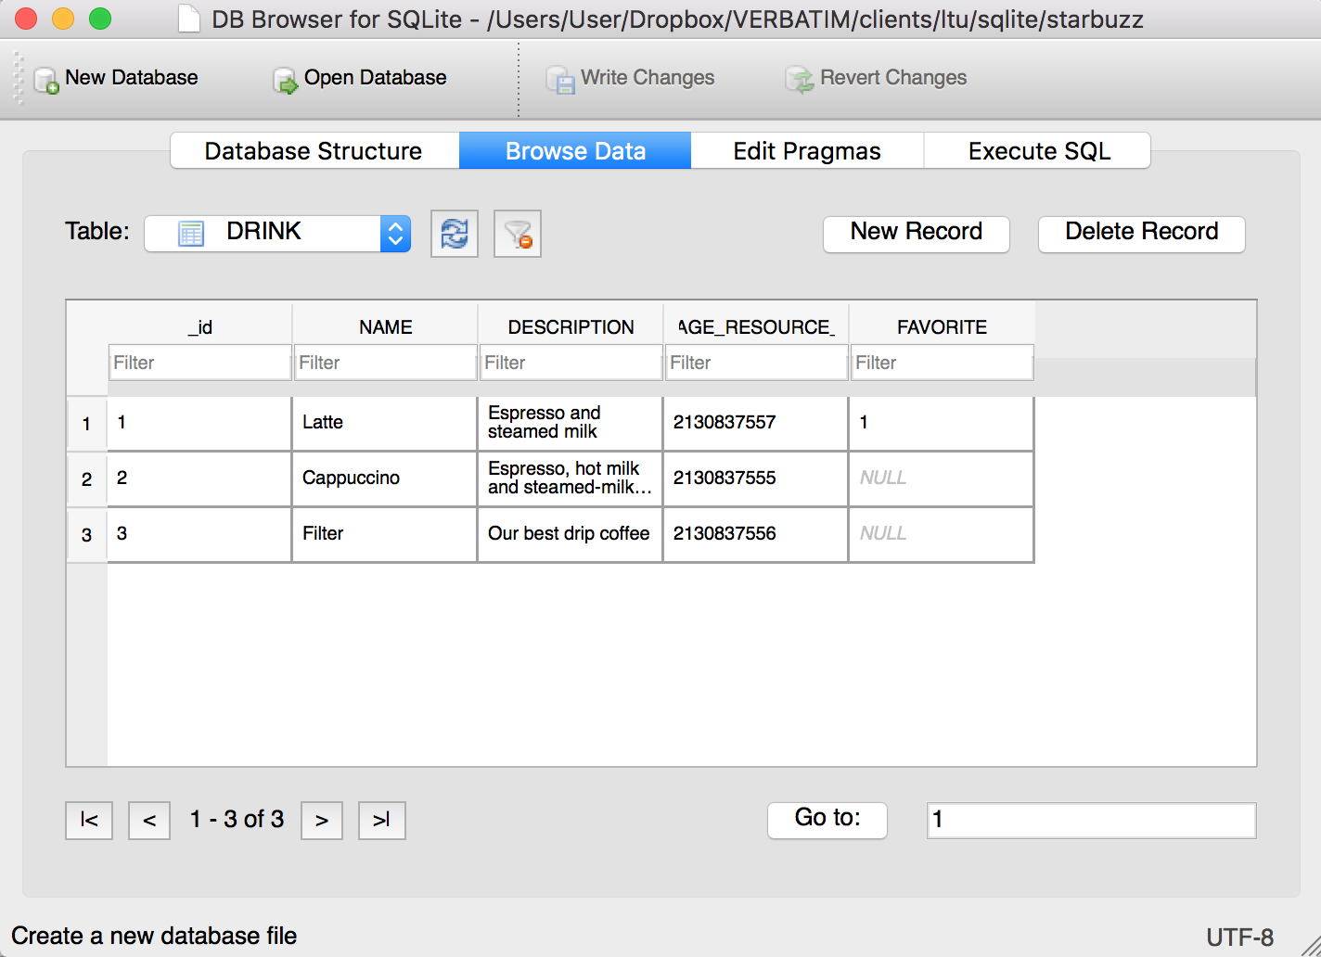
Notes:
adb pull /data/data/com.hfad.starbuzz/databases/starbuzz .

Slide 83
Bullet Points
A Cursor lets you read from and write to the database.
You create a cursor by calling the SQLiteDatabase query() method. Behind the scenes, this builds a SQL SELECT statement.
The getWritableDatabase() method returns a SQLiteDatabase object that allows you to read from and write to the database.
The getReadableDatabase() returns a SQLiteDatabase object. This gives you read-only access to the database. It may also allow you to read from and write to the database, but this isn’t guaranteed.
Navigate through a cursor using the moveTo*() methods.
Get values from a cursor using the get*() methods.

Slide 84
Bullet Points
Close cursors and database connections after you’ve finished with them.
A CursorAdapter is an adapter that works with cursors. Use SimpleCursorAdapter to populate a ListView with the values returned by a cursor.
Design your app so that you put useful content in your top-level activity.
The CursorAdapter changeCursor() method replaces the cursor currently used by a cursor adapter to a new cursor that you provide. It then closes the old cursor.
Run your database code in a background thread using AsyncTask.

